Slide 1
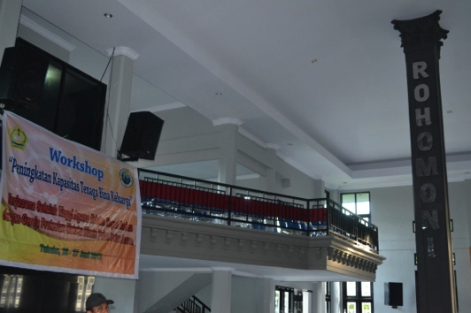
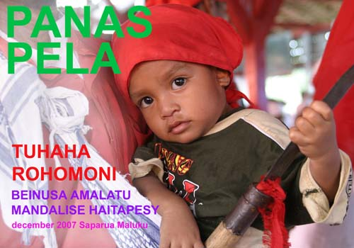
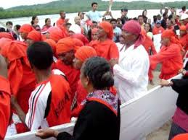
New York SouthEAST Asian Networks
New York University
New York, August 14, 2019
Indonesia’s Religions and Their Contested Narratives: Government Policy and Cultural Chronicle
Izak Y. M. Lattu (izak.lattu@uksw.edu)
Center for the Study of Religion, Pluralism, and Democracy
Satya Wacana Christian University, Salatiga, Indonesia

Slide 4
15 Provinces out of 33 in Indonesia among University Students

Slide 5
Ritual and Symbolic Performance in Toraja

Slide 6
Torajan Tongkonnan

Slide 7
Halal Bihalal in Solo

Slide 8
Folksong in MALUKU
Malukan topoi of collective imagination imagination: Pop, Dangdut, Hip Hop
http://www.youtube.com/watch?v=8x6u-jAGozo
http://www.youtube.com/watch?v=3vg2qpJzIl0
http://www.youtube.com/watch?v=bUGm562ueHw

